Slide 1
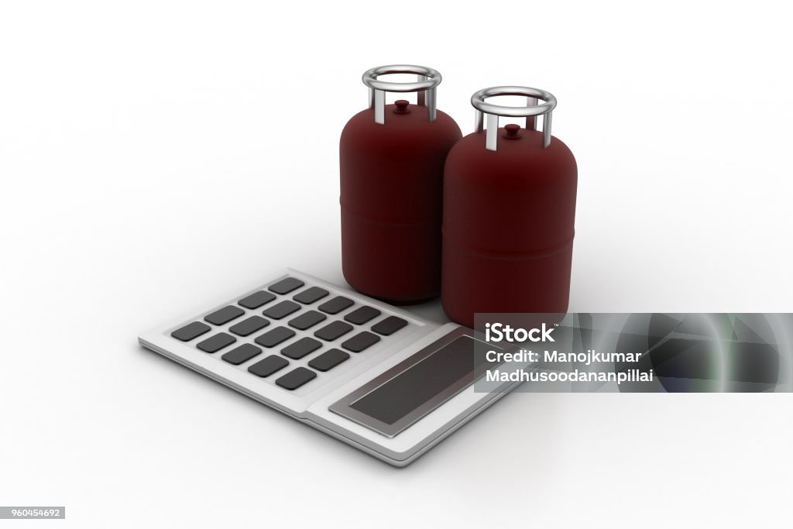
GAS USAGE CALCULATOR
MIN IPROJECT

Slide 2
GAS USAGE CALCULATOR
NAME: R SRI GOVINDHA NARASIMMAN
REG NO: 21TH0035
DEPT: INFORMATION TECHNOLOGY
TITLE: GAS USAGE CALCULATOR

Slide 3
LANGUAGE
My project language is css , html and java script

Slide 4
Existing and Drawbacks
Drawbacks
Existing
We don’t know the level of the gas present in gas cylinder
We can’t judge it manually
We can’t open it and see
Its unpredictable manually
We don’t know the longlast of the gas
the existing app has more difficult
it asks more inputs
its not user friendly
its not understsndable

Slide 5
OVERCOME
With the use of my project, one can get aware that gas is going to get over
Gas level is low ,book it !!! . Its easy to calculate it with my project
”It’s tribute to all mothers”
family
Hotels
4 or more members
3 or 4 burners
5% of gas used/day
100 or more members
10+ burners
25 to 30% of gas used

Slide 6


